Slide 1
Naukri FastForward Privilege Report Generation App
by
Prithwiraj Samanta
Under the supervision of
Dr. Rashmi Panda
Department of Computer Science and Engineering
INDIAN INSTITUTE OF INFORMATION TECHNOLOGY, RANCHI
(An Institution of National importance under act of Parliament)
(Ranchi - 834010), Jharkhand

Slide 2
Project Details
Student Details
Name | PRITHWIRAJ SAMANTA
Registration Number | 2018UGCS002R | Roll No | CSE/02
Email Address | psamanta.btech.cs18@iiitranchi.ac.in | Phone No (M) | 6204570243
Project Details
Project Title | FastForward Privilege Report Generation
Project Duration | 6 months (approx.) | Date of reporting | 3 Jan 2022
Organization Details
Organization Name | InfoEdge India Limited
Designation | Software Development Intern
Full postal address | Info Edge (India) Limited, B - 8, Sector - 132, Noida - 201304, India
Website address | http://www.infoedge.in/
Supervisor Details
Supervisor Name | Dr Rashmi Panda
Designation | Assistant Professor (ECE Department)
Full contact address | IIIT Ranchi, Science and Technology Campus, Namkum, Ranchi - 834010
Email address | rashmipanda@iiitranchi.ac.in | Phone No (M) | 9861144096

Slide 3
Outline
Introduction ……………………………………………………….. 4
Motivation ……………………………………………………….. 5
Methodology ……………………………………………………….. 6
Implementation ……………………………………………………….. 9
Result and Analysis ……………………………………………………….. 17
Conclusion ……………………………………………………….. 18
Future Work ……………………………………………………….. 19
App Demonstration during presentation of Result and Analysis

Slide 4
Introduction
Naukri.com is a platform for assisting both Jobseekers and Recruiters
At, Naukri App development team, we create different Apps for the same.
I am working on two App for in this internship – 1) Naukri FastForward Privilege report generator, 2) IOS Naukri Jobseeker App (Main App)
Naukri FastForward is a team which deals with premium services to enhance and speed up job search process

Slide 5
Motivation
IOS Naukri Jobseeker App helps user to find new jobs and connect with the recruiter without any fee.
Content Feed is important part of many apps, it helps the user to ease their stress the looking for a job.
There are many Apps like LinkedIn which is promoting different non-professional contents in their services
Naukri FastForward Privilege Report Generator App, as the name suggest generates a PDF, after collecting statistical data from different sources .
It allows user to get live-statistics on the go

Slide 6
Methodology
While working on the IOS App, Scrum Development model is followed, and for FF Privilege Report I am following given Timetable.
Task is assigned by mentor, which have deadline of 7/14 days. A number of task can be assigned at once with same deadline.
If the task is related to GUI, then my work involves identifying, and breaking down into small reusable components, creating GUI, writing communication, data formatting, and UI rendering logic.
If the task is not related to GUI, then my work involves directly writing the logic.

Slide 7
Methodology
Description | Time Period
App Architecture Design, Setting Up Databases and Logics for Themes, introduction session with all businesses | 3rd Jan - 15th Jan
Navigators and Tabs, GUI of Login, Preload, WebView | 15th Jan - 31st Jan
PDF Engine using Maths and Graphic Design | 1st Feb - 15th Feb
GUI of all tabs of Report page | 16th Feb - 28th Feb
Animations, and optimizations for Chrome and Android, Deep Linking and Notification | 1st March - 15th March
Content Feed Component GUI, API Integration of FF Report App | 16th March - 31st March
Database Logic | CTA | UBA of Content Feeds | 1st April - 15th April
Integration of FF App into iOS App | API Integration | 16th April - 30th April

Slide 8
Implementation
Animations
- Drawn animations from scratch for hiring across cross functional areas
Optimization of Chrome and Android
Fixed security issue of cross-site scripting and download PDF option for chrome
Fixed permission issues with android, and file saving feature improvement
Deep Linking
It allows one to open any tab or page of the app using links or from other apps
Notification
- Added notification (Instant and Scheduled) feature for both Android and IOS

Slide 9
Implementation
API Integration of FF Report App
- Drawn animations from scratch for hiring across cross functional areas
Content Feed Component GUI
Fixed security issue of cross-site scripting and download PDF option for chrome
Fixed permission issues with android, and file saving feature improvement
Database Logic | CTA | UBA of Content Feeds
Content-Feed widget for displaying content related to technology
Fetch data from API, Store in local database, Send UBA, Track user actions, User feedbacks
Integration of FF App into iOS APP | API Integration
- Adding FF App into iOS App as a module

Slide 10
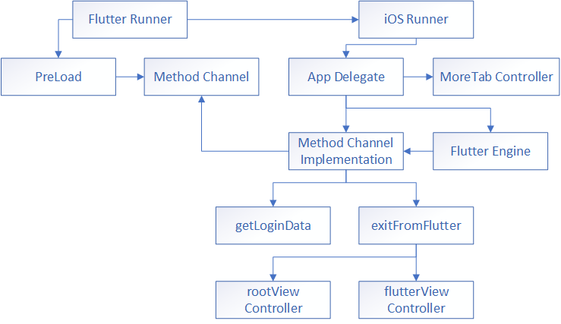
Implementation

Slide 11
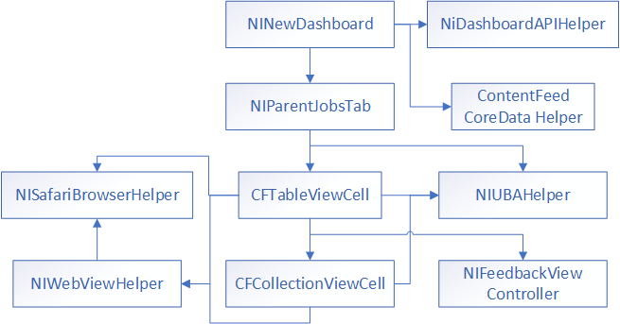
Implementation

Slide 12
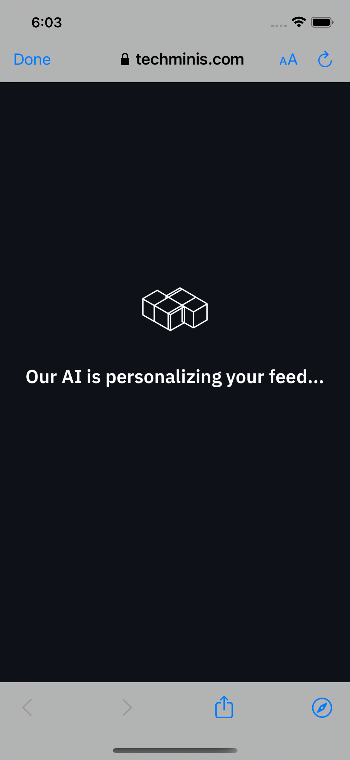
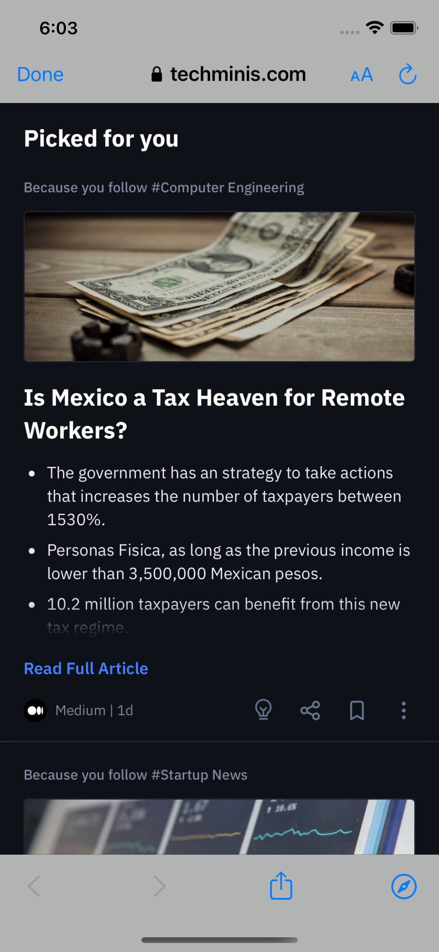
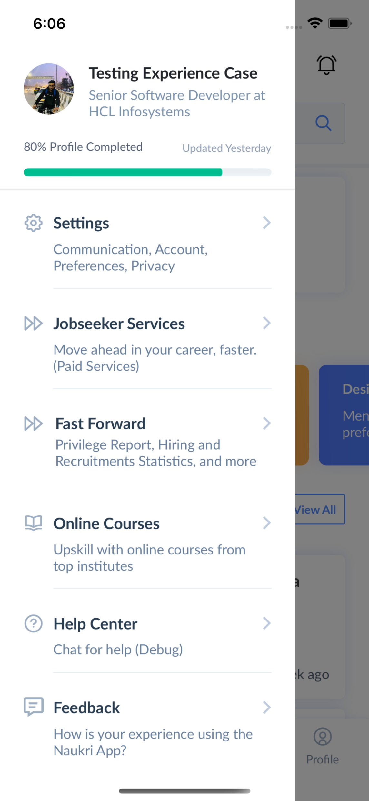
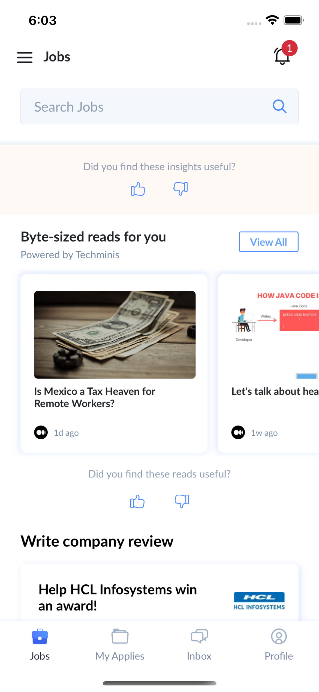
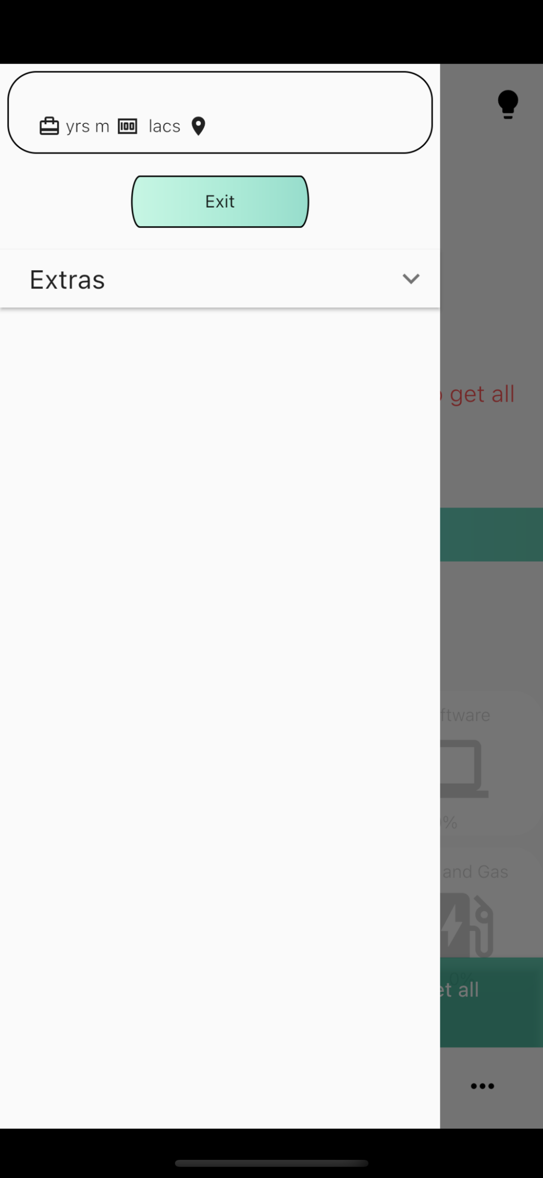
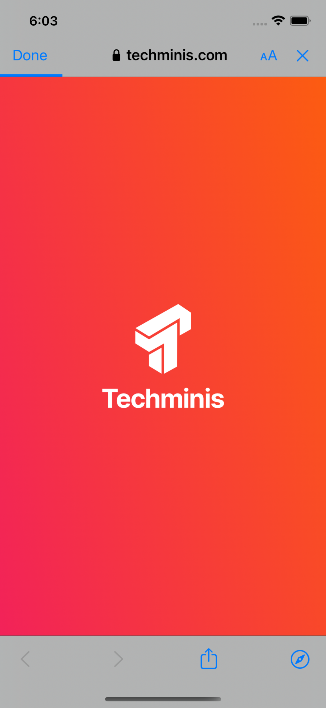
Result and Analysis

Slide 13
Conclusion
Created a Techminis Widget in iOS App capable of showing trending newsfeed.
Integrated Flutter App into iOS App as a module.
Added more Features and APIs into Flutter App.

Slide 14
Future Work
Reducing loading time, and fallback contents of FF App
Adding more widgets related to Content-Feed of iOS App
Adding more advanced feedback option for Content-Feed
Building and Publishing App to Apple App Store

